Slide 1
LPL Hackarama 2023
“Future of fintech"
January 28-29th, 2023

Slide 2
Team #21 – <Phi Delt>
01 Andres Choucair
02 Aidan Shotland
03 Jason Fabian
04 Garen Vehouni

Slide 3
<AI/ML Robo-Advisor>
The problem we tackled was figuring out how to accurately make investment recommendations depending on a user's age, income, desired risk, and total amount invested.

Slide 4
Tech Stack
HTML
CSS
Java
Environments: InteliJ, VS Code
Attempted to use Angular to connect the data pathway from frontend HTML to backend Java

Slide 5
Solution Description
Takes in data from user input
Comes up with a financial guidance based on the user's data for investing between bonds and stocks
After giving an accurate recommendation for the specific user, it asks if the user wants to withdraw cash
If yes, then the cash is withdrawn from the account
Once the cash is withdraw, the Robo-Advisor redistributes the leftover funds into the desired outputs
For example, if the desired distribution between stocks and bonds is 70-30, it will make sure that the split is still that after withdrawing cash

Slide 6
Project Significance
Provides a low-cost, automated investment management service to investors who may not have the resources or knowledge to work with a traditional financial advisor
Eliminates the fear of starting to become financially aware
Cancels human biases in investment decision making
Algorithms are designed based on data and mathematical formulas

Slide 7
Challenges
Finding a place to start
The limited time frame and financial experience hindered us at the start of the project
We were also unable to connect the front cut HTML code to the back end Java code
After extensive research in finance and software these challenges have taught us a lot

Slide 8
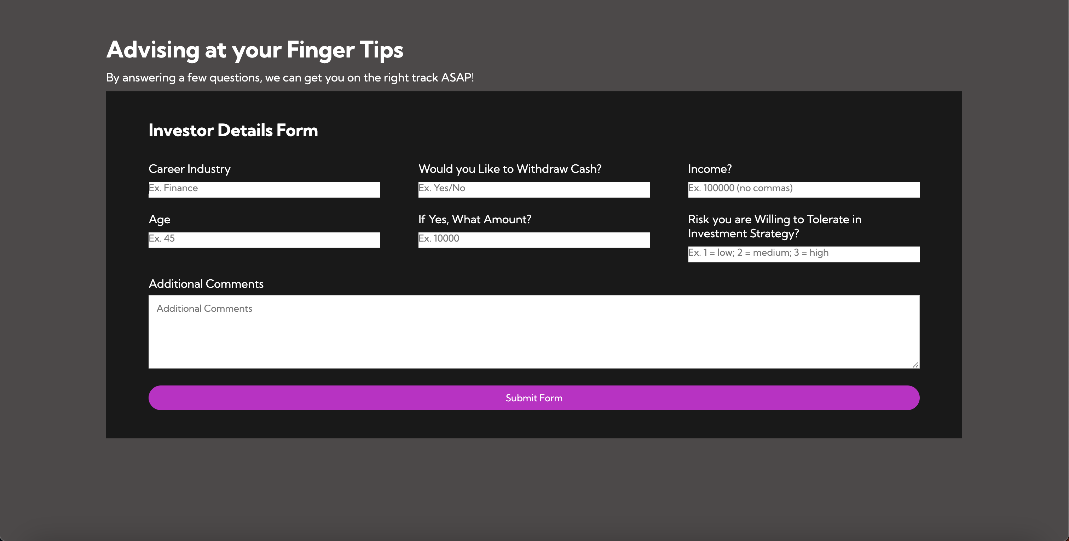
demo

Slide 9
Thank you!

